Slide 1
Quantum simulators
in Machine Learning
M. E. Lebedev
Saint-Petersburg, IFMO
2017

Slide 2
M. E. Lebedev
Quantum simulators in Machine Learning
Quantum information approach: history
1970-е: S. Wiesner – понятие кубита, R. S. Ingarden – квантовая теория информации.
1980-е: Ю. И. Манин, Р. Фейнман – идея квантового компьютера, P. Benioff, D. Deutsch – первые мат. Модели квантового компьютера.
1990-е: D. Simon, P. Shor, L. Grover и др. – базовые квантовые алгоритмы: разложение числа на множители, поиск в базе данных.
1995 г. Первая экспериментальная реализация квантового вентиля.
1998 г. 2- и 3- кубитные квантовые компьютеры, первая экспериментальная реализация квантовых алгоритмов.
2000-2003 гг. 5- и 7- кубитные компьютеры, разложение числа 15 на множители.
2012 г. Квантовый адиабатический симулятор компании D-Wave.
2/17

Slide 3




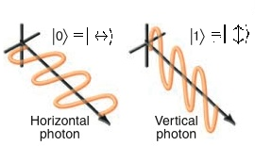


M. E. Lebedev
Quantum simulators in Machine Learning
Quantum information approach
Qubit (quantum bit) is superposition state
Where is logical «0» and is logical «1». They are two orthogonal states
in Hilbert space for quantum system.
Is probability to find qubit in the state
Is probability to find qubit in the state
Normalization condition
1
Physical realization :
1. Photon polarization:
2. Two level atomic system:
Ground state
Excited state
3. Electrons in quantum dots:
- spin «UP»
- spin «DOWN»
3/17

Slide 4

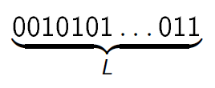
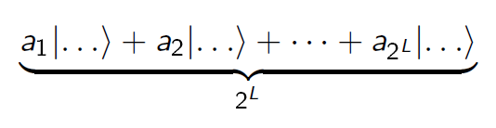

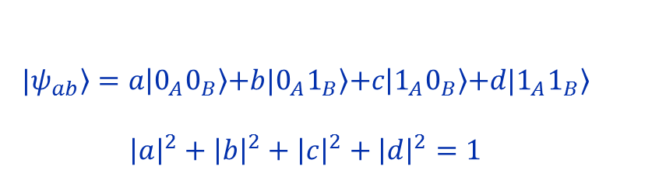
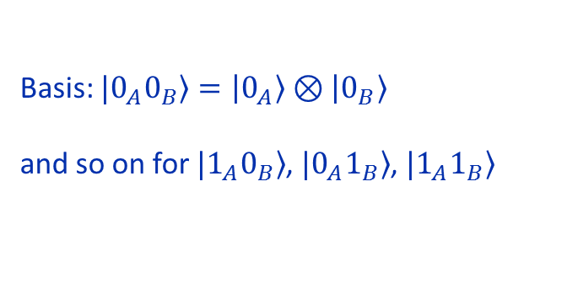
M. E. Lebedev
Quantum simulators in Machine Learning
Quantum excellence
Classical computer:
Quantum computer:
L bits – 1 state
L qbits – superposition of states
complex amplitudes!
Quantum entanglement
$A, B$– two-level states
$$|\left.ψ_{ab}\right\rangle =\left.a\left|0_{A}0_{B}\right.\right\rangle \left.+b|0_{A}1_{B}\right\rangle \left.+c\left|1_{A}0_{B}\right.\right\rangle \left.+d|1_{A}1_{B}\right\rangle$$
$${\left|a\right|}^{2}+{\left|b\right|}^{2}+{\left|c\right|}^{2}+{\left|d\right|}^{2}=1$$
Basis: $|\left.0_{A}0_{B}\right\rangle =\left.\left|0_{A}\right.\right\rangle ⊗\left.\left|0_{B}\right.\right\rangle$
and so on for $|\left.1_{A}0_{B}\right\rangle$, $|\left.0_{A}1_{B}\right\rangle$, $|\left.1_{A}1_{B}\right\rangle$
4/17

Slide 5

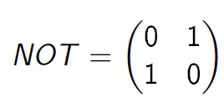

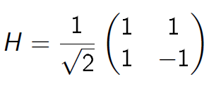
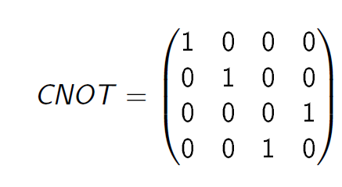
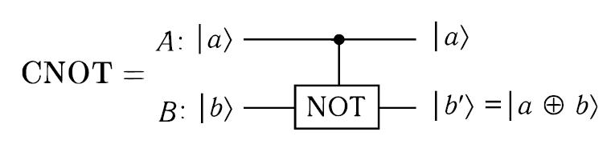
M. E. Lebedev
Quantum simulators in Machine Learning
Quantum gates
We can control quantum state: operators act in a - dimensional
Hilbert space
5/17

Slide 6

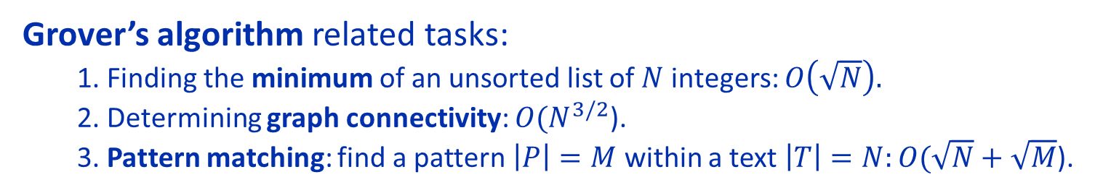
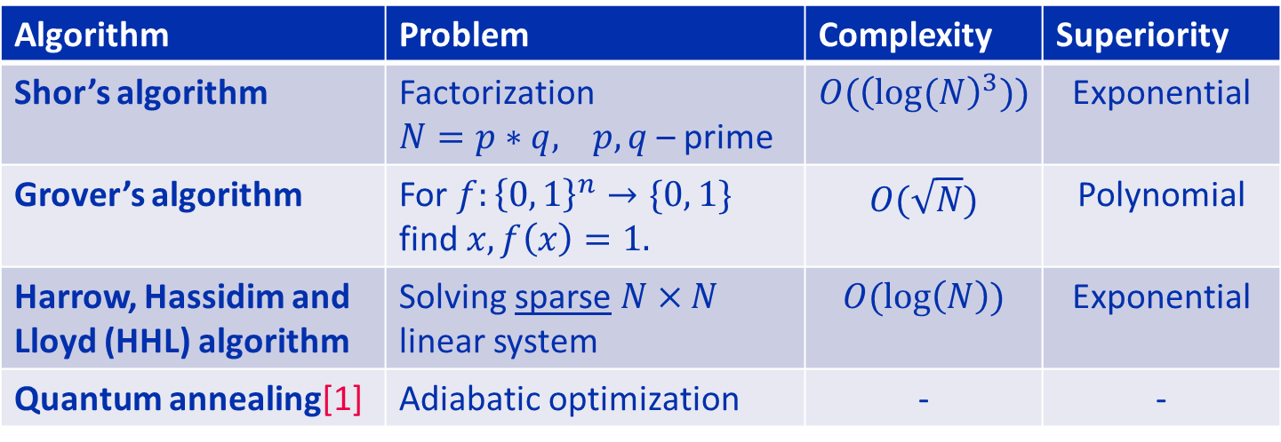
M. E. Lebedev
Quantum simulators in Machine Learning
Quantum algorithms
Algorithm | Problem | Complexity | Superiority
Shor’s algorithm | Factorization $N=p∗q,$ $p, q$ – prime | $$O({\left(log⁡(N\right)}^{3}))$$ | Exponential
Grover’s algorithm | For $f:{\left\{0, 1\right\}}^{n}→\{0, 1\}$ find $x, f\left(x\right)=1.$ | $$O(\sqrt{N})$$ | Polynomial
Harrow, Hassidim and Lloyd (HHL) algorithm | Solving sparse $N×N$ linear system | $$O(\log\left(N\right))$$ | Exponential
Quantum annealing[1] | Adiabatic optimization | - | -
Grover’s algorithm related tasks:
1. Finding the minimum of an unsorted list of $N$ integers: $O\left(\sqrt{N}\right).$
2. Determining graph connectivity: $O(N^{3/2}$).
3. Pattern matching: find a pattern $\left|P\right|=M$ within a text $\left|T\right|=N:O(\sqrt{N}+\sqrt{M}$).
[1] The D-Wave 2000Q™ , Quantum Computer, Technology Overview, https://www.dwavesys.com/quantum-computing
6/17

Slide 7
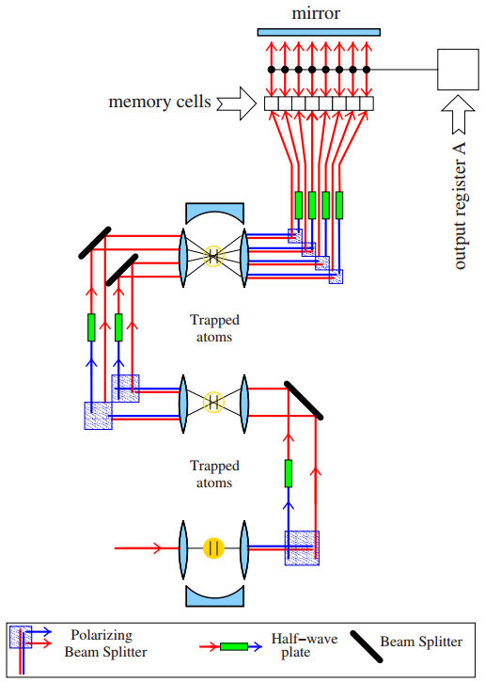
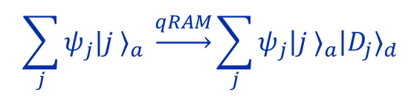
M. E. Lebedev
Quantum simulators in Machine Learning
Quantum qRAM
$$\sum_{j}{ψ_{j}|j ⟩_{a} \underset{→}{qRAM}\sum_{j}{ψ_{j}\left|j ⟩_{a}\right|D_{j}}}⟩_{d}$$
address state
output state
Quantum RAM access classical information
in quantum superposition.
V. Giovannetti, S. Lloyd, and L. Maccone,
PHYSICAL REVIEW A 78, 052310 (2008)

Slide 8
M. E. Lebedev
Quantum simulators in Machine Learning
Necessary conditions
1. Ultra-stable source of single photon.
2. Optical schemes with minimal losses.
3. Media with high Kerr nonlinearity.
4. High efficiency photodetectors of single photons.
8/17

Slide 9
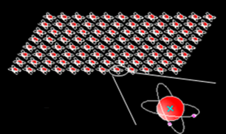
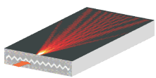
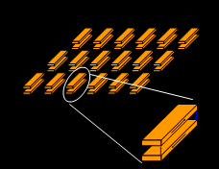
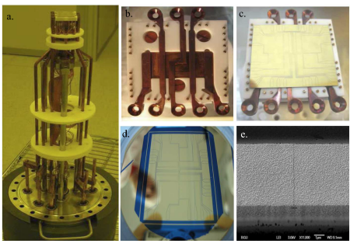
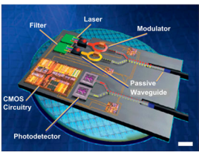
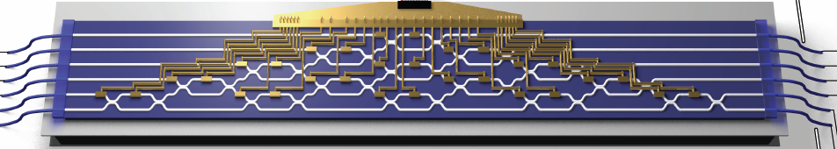
M. E. Lebedev
Quantum simulators in Machine Learning
Physical realizations: on-chip quantum simulators
Lattices of atoms Waveguides and circuits Мetamaterials & artificial atoms
Atomic circuits
Photonic circuits
Plasmonic circuits

Slide 10
M. E. Lebedev
Quantum simulators in Machine Learning
Machine learning: tasks
10/17

Slide 11
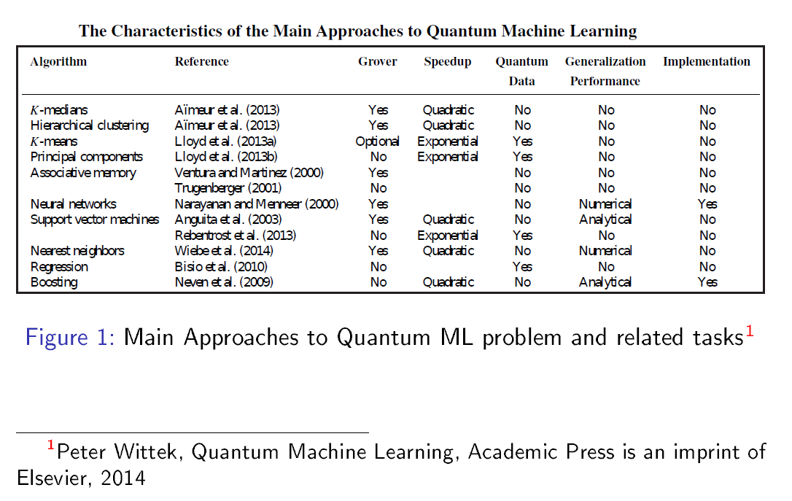
M. E. Lebedev
Quantum simulators in Machine Learning
Machine learning: achievements
11/17

Slide 12

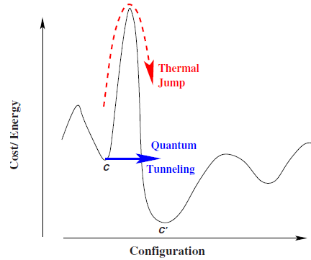



M. E. Lebedev
Quantum simulators in Machine Learning
Quantum Annealing
Escape rate at
Tim Byrnes, Kai Yan and Y. Yamamoto,
New J. of Physics 13 (2011) 113025
Accelerated optimization problem search
using BEC
Marandi, et al, NATURE Phot., 2014
Network of OPO as a coherent Ising machine
at
Natalia G. Berloff, et al , arXiv 1607.06065v1 ,
20 Jul 2016
The XY Hamiltonian in polariton simulators
Arnab Das and Bikas K. Chakrabarti, RMP , 2008
Vital question: how quantum system chose the way?
12/17

Slide 13
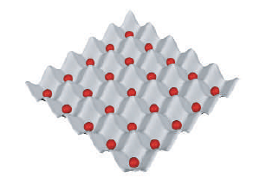
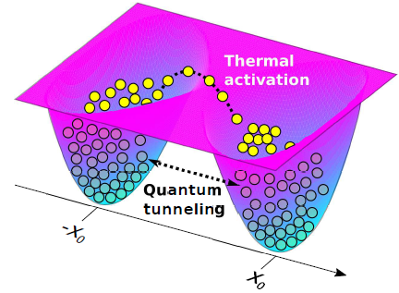
M. E. Lebedev
Quantum simulators in Machine Learning
Coupled Exciton - Polariton Condensates
13/17

Slide 14

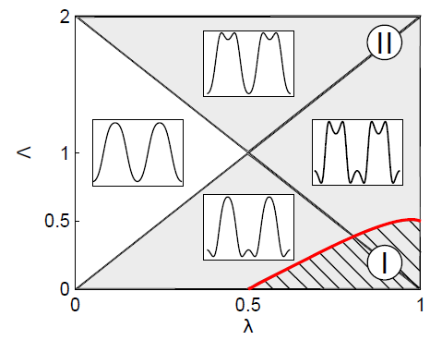


M. E. Lebedev
Quantum simulators in Machine Learning
Quantum phase model
Extended model for exciton polariton Josephson junction model Hamiltonian
Diagram of potential energy landscape
14/17

Slide 15
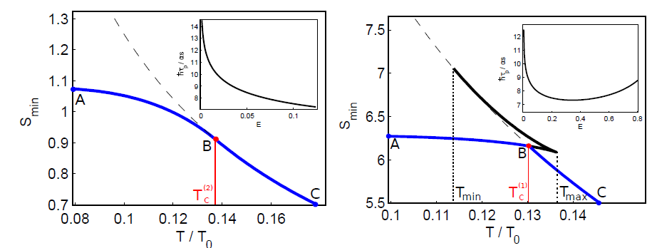

M. E. Lebedev
Quantum simulators in Machine Learning
Quantum – Classical Phase Transitions
2nd order
1nd order
Action
Is temperature of blue shift
For narrow band semiconductors phase transition temperature is 0,5 – 2 Kelvins !
It is less that temperature of condensation
15/17

Slide 16
M. E. Lebedev
Quantum simulators in Machine Learning
Conclusion
Quantum information approach was briefly discussed.
2. Quantum simulators can be efficiently used for
Machine Learning tasks.
Extended model for exciton polariton Josephson
junction satisfies the quantum annealing conditions
and can be used for adiabatic optimization tasks.
16/17

Slide 17
Thanks for your attention!
17/17

